Slide 1
THE RISE OF THE WORLD DICTATOR
Revelation 13:1-10
FBC-PC 2-16-14AM

Slide 2
ANTIGOD’S (WORLD DICTATOR) POWER OVER THE REVIVED ROMAN EMPIRE 13:1; 17:8-17; Dan. 7:23-24
“Sea” – Literally the Mediterranean Sea; symbolically “peoples” Dan. 7:2-3,17; Rev. 17:1,15; 7 world empires (Mts., Kings, Kingdoms) 1. Egypt; 2. Assyria ; 3. Babylon ; 4. Medio Persia ; 5. Grecian (1>4); 6. Roman Empire; 7. Ottoman (Islamic) Empire; 8. Revival of Islamic leader >>Tribulation. See animals in verse 2

Slide 3
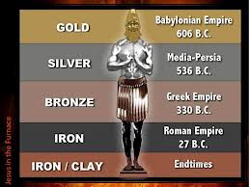
Daniel 2:27-45

Slide 4
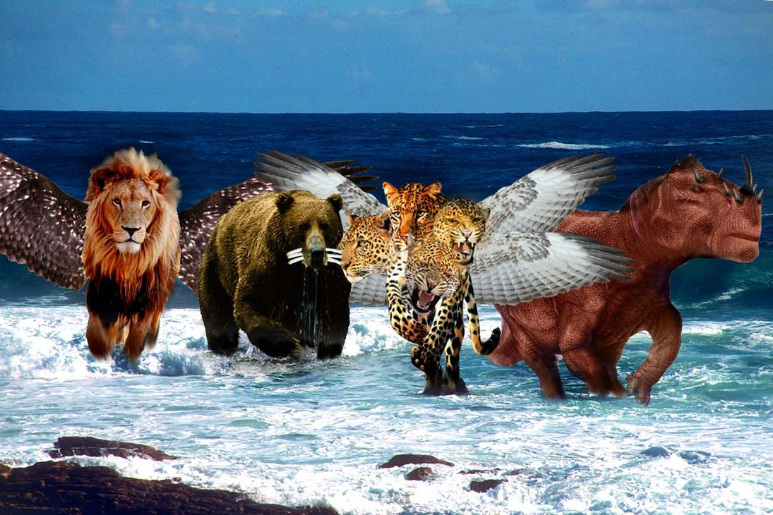
The Four Beasts of Daniel 8 Babylon; Medio-Persia; Greece, Rome

Slide 5
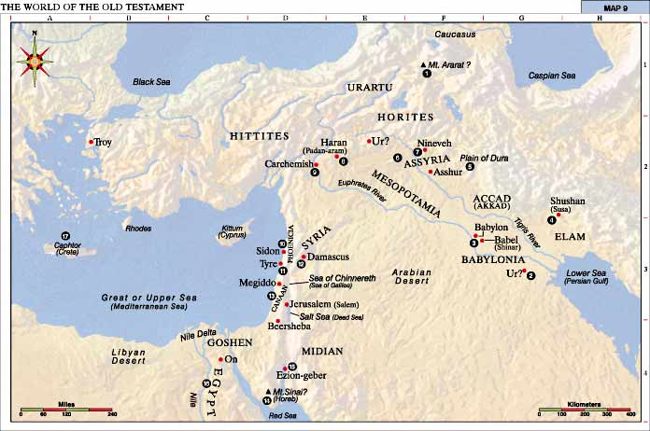
<6. Roman Empire>
2. Assyria
<5. Greece>
7. Turkey
Ottoman
4. Medio-Persia
3. Babylon -Iraq
Arabia
1. Egypt

Slide 6
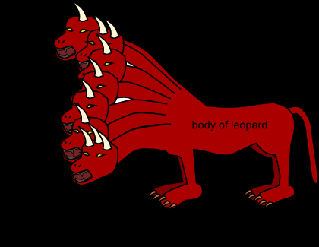
Seven heads
Ten horns
Feet of bear
Feet of brass
Mouth of Lion
Teeth of Iron
The Fourth Beast
Roman and Revised Roman Empire

Slide 7
ANTIGOD’S POWER OVER THE REVIVED ROMAN EMPIRE 13:1; 17:8-17; Dan. 7:23-24
“Sea” – Literally the Mediterranean Sea; symbolically “peoples” Dan. 7:2-3,17; Rev. 17:1,15; 7 world empires (Mts., Kings, Kingdoms) 1. Egypt; 2. Assyria ; 3. Babylon, Dan. 2; 4. Medio Persia ; 5. Grecian (1>4); 6. Roman Empire; 7. Ottoman (Islamic) Empire; 8. Revival of Islamic leader >>Tribulation. See animals in verse 2

Slide 8
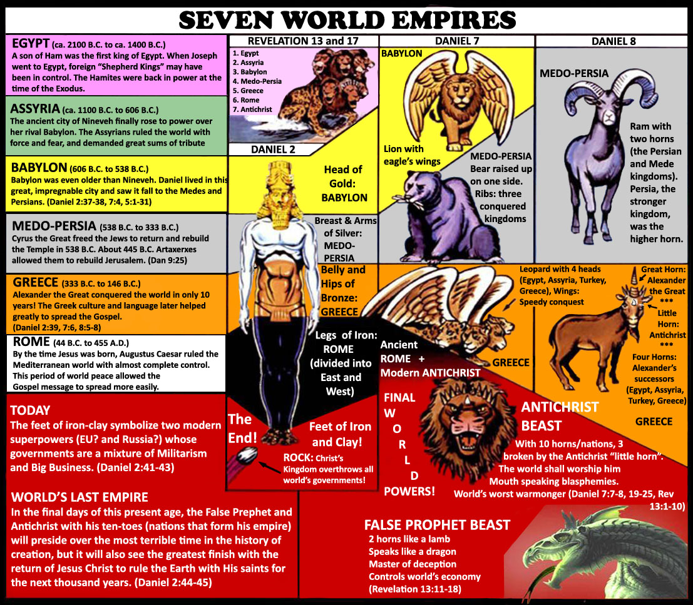

Slide 9
ANTIGOD’S (World Dictator) KINGDOM: the eighth world kingdom 13:2-3
Dan. 7:8, 23-24
8:20-26
11:40-45
Zech.9:17
Rev. 17:8-17

Slide 10
ANTIGOD’S (World Dictator’s) SOURCE OF POWER: 13:4
Dan. 8:21
11:36-39
2 Thess. 2:8-12
Dragon Rev. 12:3-4,9

Slide 11
ANTIGOD’S (World Dictator’s) BLASPHEMY AND REIGN 13:5-6
Dan 7:8,11, 20-25
11::36-45
12:7
Rev. 11:1-3
12:6,14
17:8-17

Slide 12
ANTIGOD’S WAR ON THE SAINTS 13:7, 15-16
Rev. 15:2-4
20:4
Dan. 7:21
8:24
11:35-45
12:1,7
Matt.24:15-22

Slide 13
ANTIGOD’S (World Dictator’s) LIMITED REIGN 13:8-10, 1-5
Rev.17:8-17
Dan. 2:44-45
7:8, 23-24
11:40-45
Zech. 14:1-11
Mt. 25:31-46
Rev. 14:9-11
16:13-16

